Slide 1

Towards sustainable energy management : Federated Learning
By
Vatsa Khatri (BT21CSE006)
Prajwal Sam Rachapudy (BT21CSE015)
Harsh Deshmukh (BT21CSE020)
Rashmi Sharma (BT21CSE022)
Under guidance of
Dr. PVN Prashanth

Slide 2
Problem Statement
Achieve accurate energy load predictions using FL while maintaining data privacy and enabling efficient, scalable energy management.
We propose leveraging Federated Learning to enable decentralized data processing across multiple energy devices (like smart meters or sensors) for accurate, privacy-preserving load prediction and management

Slide 3
Predictions using FL
The primary objective is to predict energy loads accurately across various regions and devices
Specifics:
Load Forecasting: Predict high-demand periods to optimize energy allocation.
Demand Management: Adjust supply strategies to prevent overload and reduce wastage.
Resource Optimization: Enable renewable energy integration by matching supply with demand more accurately.
Benefits:
Better predictability can lead to reduced energy wastage, cost savings, and a more resilient grid.

Slide 4
Dataset Description
STEEL INDIUSTRY DATASET
Column | Data Type | Description
date | String | Timestamp recorded every 15 minutes, format: 'DD/MM/YYYY HH:MM'
Usage_kWh | Float | Energy consumption in kilowatt-hours, target variable
Lagging_Current_Reactive.Power_kVarh | Float | Reactive power due to lagging current
Leading_Current_Reactive_Power_kVarh | Float | Reactive power due to leading current
CO2(tCO2) | Float | CO2 emissions in metric tons, indicating environmental impact
Lagging_Current_Power_Factor | Float | Efficiency of power usage with lagging current
Leading_Current_Power_Factor | Float | Efficiency of power usage with leading current
NSM | Integer | Time in seconds from midnight, tracking daily intervals
WeekStatus | String | Indicates weekday or weekend
Day_of_week | String | Day of the week
Load_Type | String | Classification of load type (e.g., Light_Load)

Slide 5
A FEW INSIGHTS
Energy usage pattern across the week
Notes:
Good afternoon everyoneBefore going through the Fedeated learning process , let us have a look at how the target variable i.e Usage KWH varies across the week with Time

Slide 6
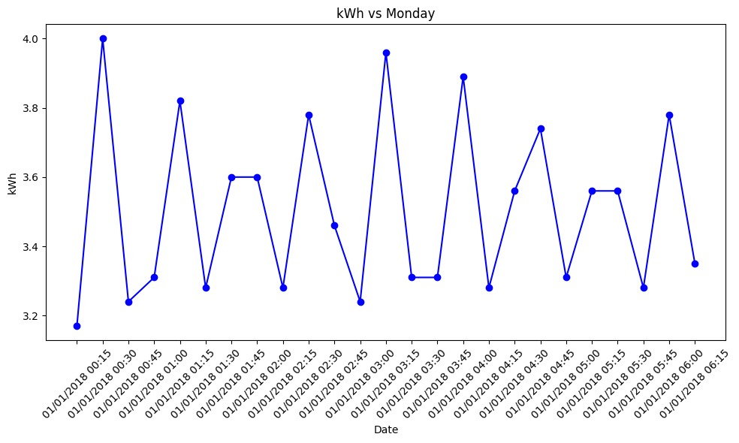
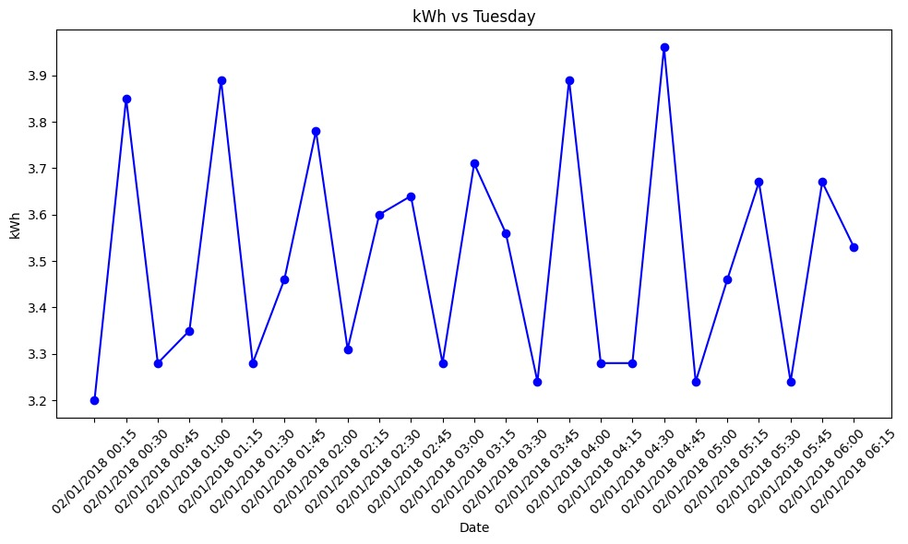
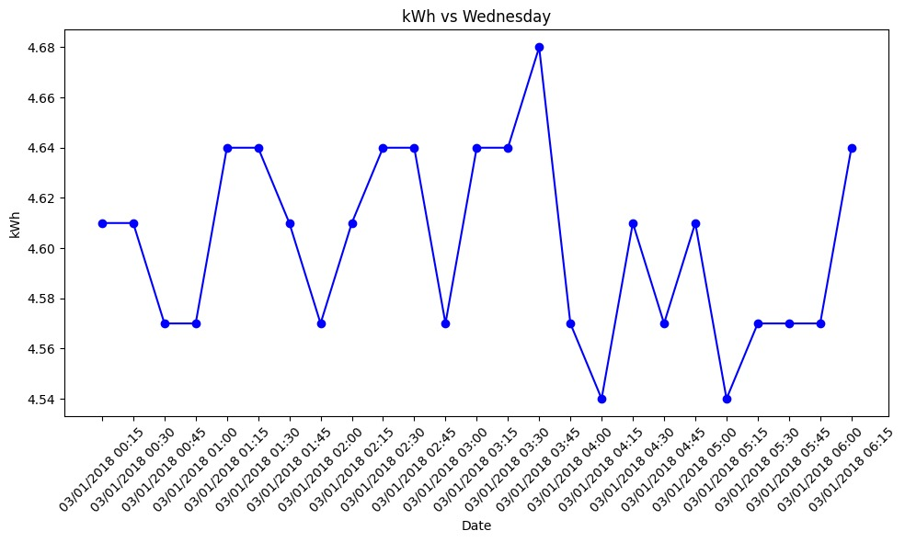
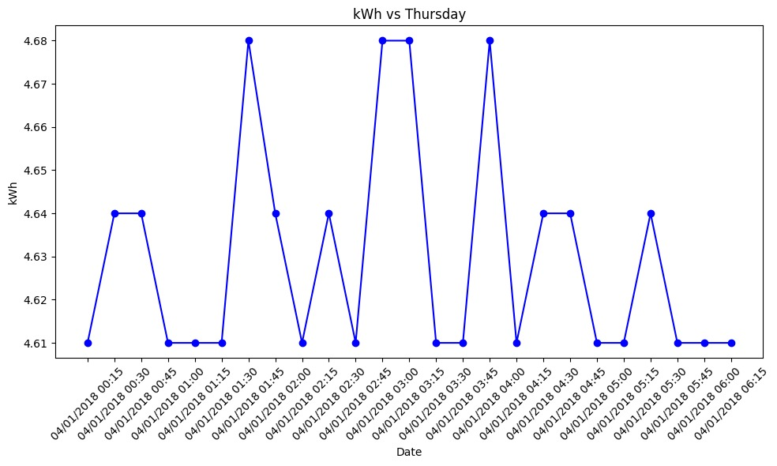

Slide 7
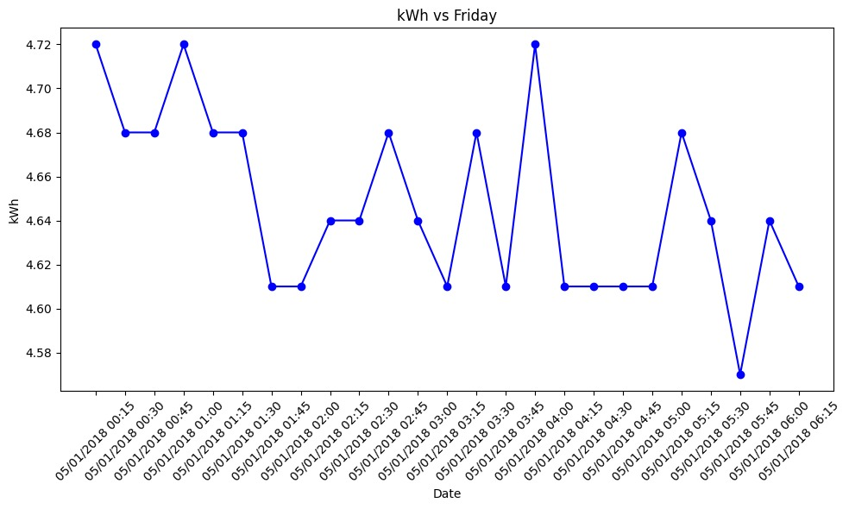
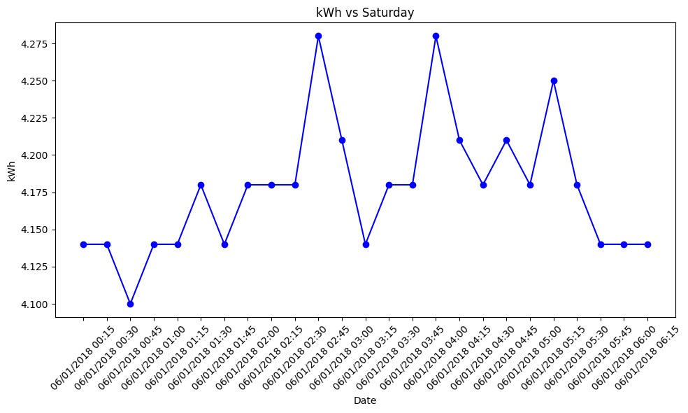
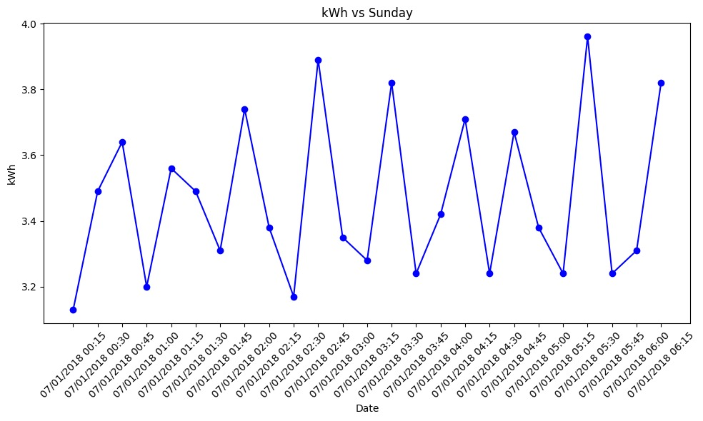

Slide 8
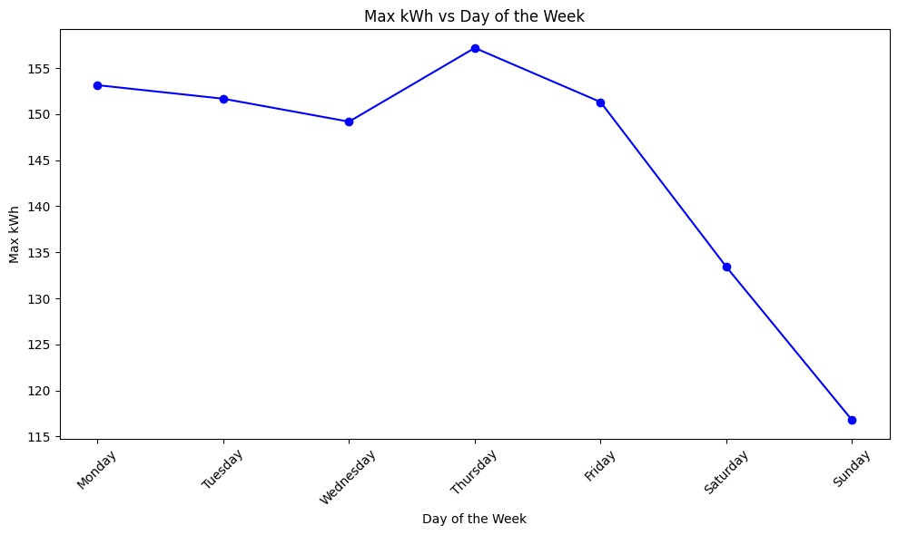
Notes:
This graph shows us Max or peak Usage for each day( entire dataset)

Slide 9
Federated Learning approach
As we can see the usage pattern is not regular and hard to predict as it depends on multiple parameters .
So we have chosen this dataset to train our FL model using Linear Regression since sending and aggregating parameters (coefficients and intercepts) is efficient in LR while maintaining a good accuracy

Slide 10
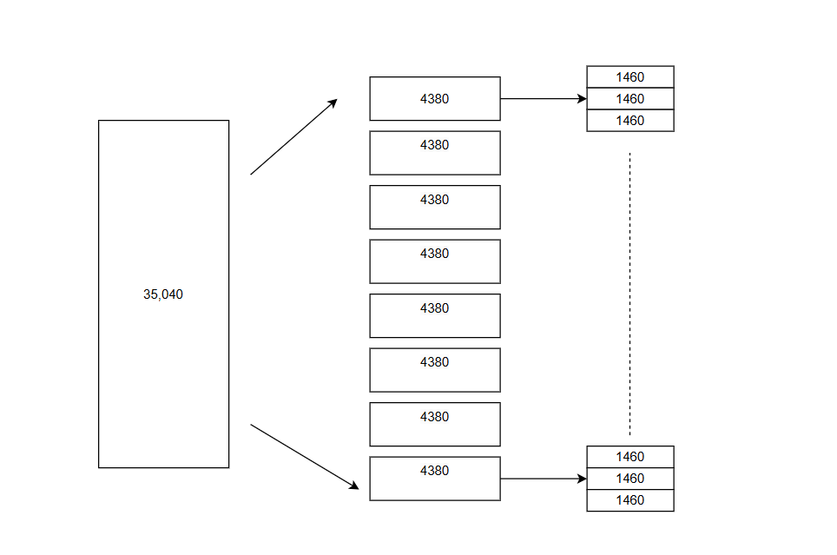
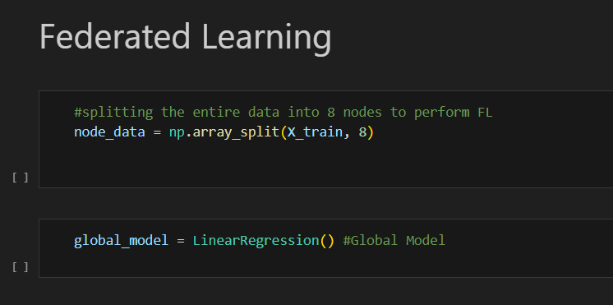
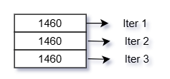
Splitting Data into Nodes
Notes:
In order to Simulate FL , we have divided the entire 35040 rows into 8 parts or "NODES" , Each node acts as an FL client
To mimic real life scenario , we have further divided each node's data into 3 parts so that we can train the model on different data with each iteration which is how the client's data is going to be in real life (since the data keeps on getting updated in real time)

Slide 11
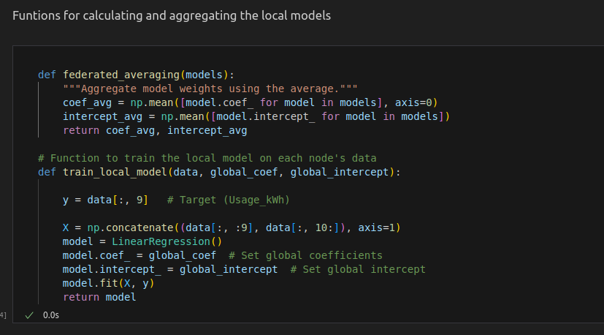
Training and Aggregating Functions

Slide 12
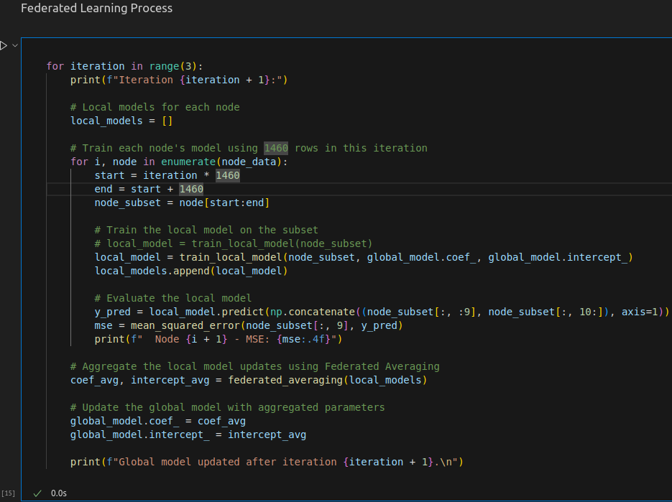
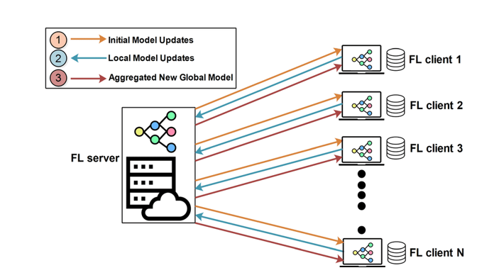
Federated Learning Process

Slide 13
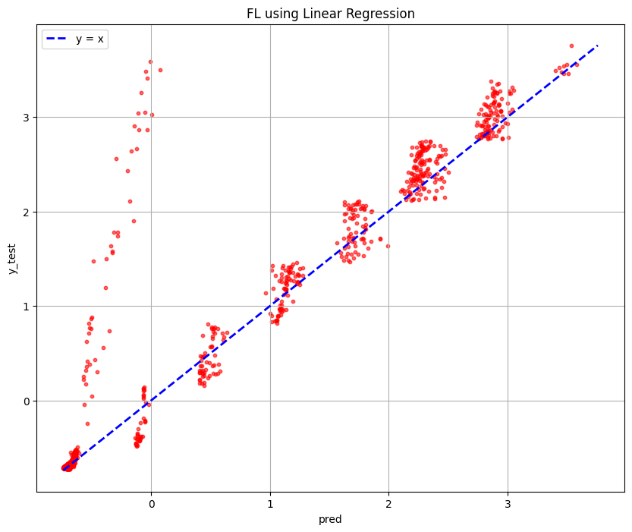
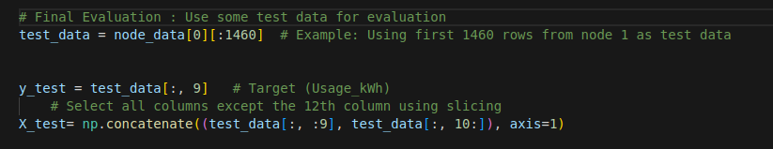
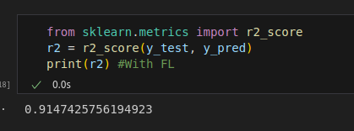
Comparison of Results(FL)

Slide 14
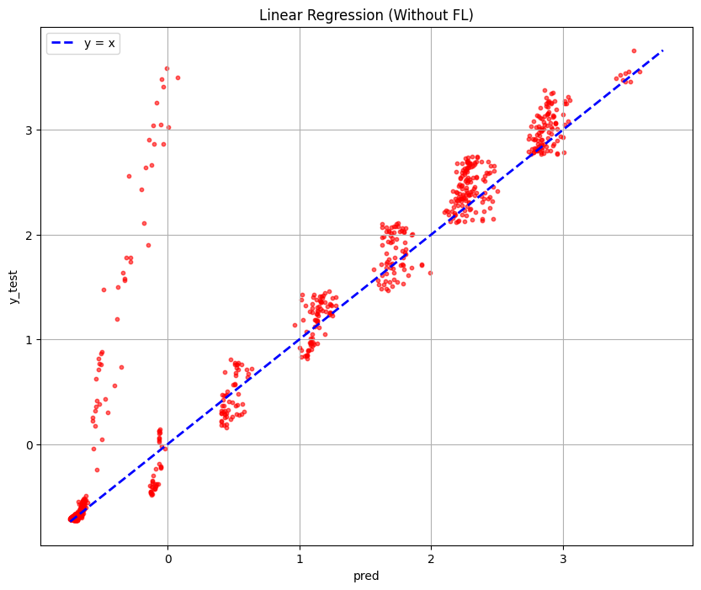
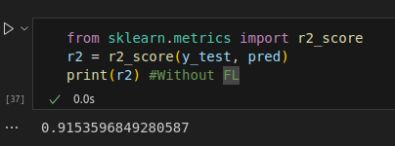
Comparison of Results(ML)

Slide 15
Challenges with FL
1)Communication Heterogeneity :
a)Some devices may not always be available for communication causing variation in the reaching of the model updates to the central server.
b)This can lead to missing updates or partial participation and as a result the aggregation process are delayed.
c) Devices with less efficient communication channels may require more time to share their updates, increasing the overall training time

Slide 16
Challenges with FL
1)Data Heterogeneity :
a)Each device (client) may have its own local dataset, and these datasets may not be independent and identically distributed .This means that data across devices could have different feature distributions, labels, or noise levels.
b) A global model trained on heterogeneous data may fail to generalize well across all clients.Some clients may get better performance than others.
c)The updates from different devices can conflict thus leads to slower convergence during training.

Slide 17
DAG Approach
Nodes:
Each client’s update forms a node in the DAG.
Let’s label the nodes as C1, C2, C3, C4, and C5, representing each client.There is also a Server node (S), which aggregates the updates from the client
Edges:
Each edge from a client node to the server node represents the transmission of an update from the client to the server.
Eg:- an edge C1 → S indicates that the update from client C1 has reached the server and can be used for aggregation.

Slide 18
DAG Approach
The updated model parameters (weights and biases of the model after training)
Client ID
Number of Data Samples
TimeStamp
Structure of a Node

Slide 19
Solution to Communication heterogeneity
Approach :
1)Assume you have 5 nodes
2)Node c1 and c2 complete training and send updates to the server and server receives them.
C1
C2
C3
C4
C5
C1
S
C2
(2 possible solution, either send DAG or updates)

Slide 20
DAG Approach
Incremental Aggregation:
1) C1 and C2 complete their local training and send their model updates to the server.
2)The server aggregates(weighted avg) these two updates to form an intermediate global model G1.
G1= sample_C1 × model_C1 + sample_C2 × model_C2
sample_C1 + sample_C2

Slide 21
DAG Approach
Weighted Reaggregation:
1) If C1 trained on 100 samples and C2 on 200 samples, C2’s update will have more influence in G1.
∴ sample_G1 = 300
2) After some time C3 finishes its training and sends its update to the server.
3) The server treats G1 as an intermediate result based on C1 and C2, and re-weights it with C3’s update to form G2.

Slide 22
DAG Approach
G2= totalSample_G1 × G1 + sample_C3 × model_C3
totalSample_G1 + sample_C3
C1
C2
S
(Updated DAG)
C2

Slide 23
DAG with edge servers
Central Server
Edge Server - 1
Edge Server - 2
C1
C3
C5
C2
C4

Slide 24
THANK YOU

